Slide 1

Escrick Primary School
RSE Information Evening
We aim to inform you of:
The school’s legal obligations on Relationships and Sex Education, and Health Education.
What we mean by ‘Sex Education’.
Your rights as a parent/carer.
How, what, why and when we intend to teach children.

Slide 2
What is RSE and why is it important?
RSE stands for “Relationships and Sex Education” and as part of Relationships and Health Education, is a new approach to teaching children about relationships.
“A comprehensive programme of RSE provides accurate information about the body, reproduction, sex and sexual health. It gives children and young people essential skills for building positive, enjoyable, respectful and non- exploitative relationships and staying safe both on and offline.”
RSE for 21st Century
2014 Supplementary Guidance to DFE guidance
Notes:
Emphasise partnership between home and school and importance of parents being on board with this work.
Explain we are going to be transparent.

Slide 3
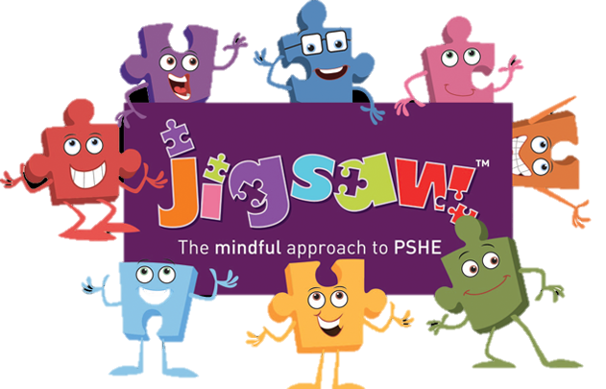
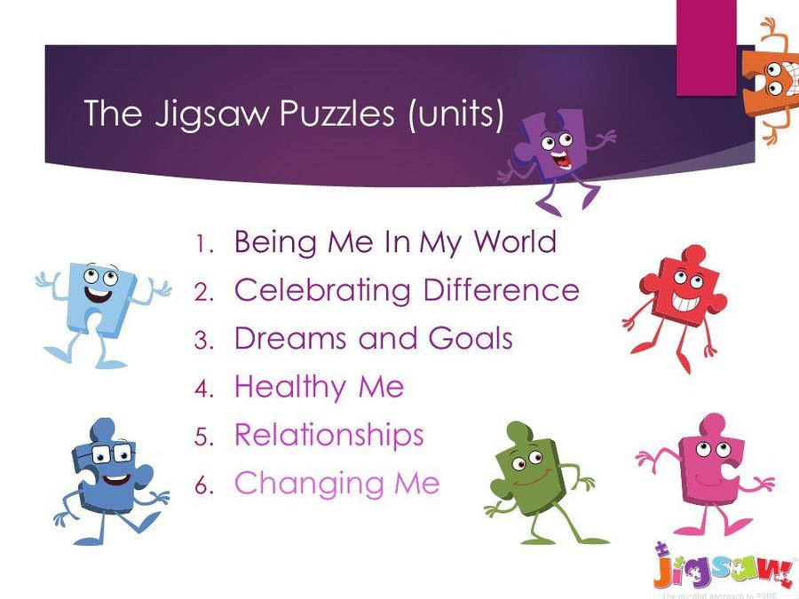
How will we be teaching RSE?
We teach RSE through ‘Jigsaw’. You may have heard your child talk about this at home.
The Jigsaw PSHE Programme includes lessons on ALL aspects of compulsory Relationships and Health Education, designed in a sensitive, spiral, age-appropriate curriculum.
The Jigsaw teaching materials integrate Personal, Social, Health Education (PSHE), emotional literacy, social skills, mindfulness, and spiritual development in a whole-school approach.

Slide 4
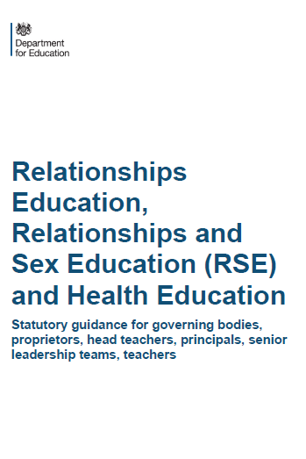
What have schools got to teach?
PRIMARY
RELATIONSHIPS EDUCATION IS COMPUSLORY
HEALTH EDUCATION IS COMPULSORY
But Sex Education is at each school’s discretion although recommended by the DfE
SECONDARY
RELATIONSHIPS EDUCATION IS COMPULSORY
SEX EDUCATION IS COMPULSORY
HEALTH EDUCATION IS COMPULSORY
Relationships Education, Health Education and Science are compulsory subjects and parents/carers do NOT have the right to withdraw their children from these subjects

Slide 5
What are the expectations for Primary Relationships Education?
Families and people who care for me
Caring friendships
Respectful relationships
Online relationships
Being safe
© Jigsaw PSHE

Slide 6
What are the expectations for Primary Health Education?
Mental wellbeing
Internet safety and harms
Physical health and fitness
Healthy eating
Drugs, alcohol and tobacco
Health and prevention
Basic First Aid
Changing adolescent body (Puberty)
Notes:
Note that lessons on puberty are considered statutory at Primary level because they have been included within compulsory Health Education

Slide 7
Puberty
What should children know about puberty?
1. Correct names for parts of the body including genitalia
2. How their bodies will change during puberty
3. How to manage these changes/ practicalities
4. Why these changes need to happen
5. How and where to ask for help if needed

Slide 8
Sex
Education is discretionary at Primary… what exactly does the guidance say?
The Department continues to recommend that all primary schools should have a sex education programme tailored to the age and physical and emotional maturity of the pupils… drawing on knowledge of the human life cycle set out in National Curriculum Science - how a baby is conceived and born’

Slide 9
At Escrick Primary School, puberty is taught as a statutory requirement of Health Education and covered by our Jigsaw PSHE Programme in the ‘Changing Me’ Puzzle (unit).
We conclude that sex education refers to Human Reproduction, and therefore inform parents of their right to request their child be withdrawn from the PSHE lessons that explicitly teach this i.e. the Jigsaw Changing Me Unit.
Year 4, Lesson 2 (Having a baby)
Year 5, Lesson 4 (Conception)
Year 6, Lesson 3 (Conception, birth)
The school will inform parents of this right by a curriculum newsletter, in the Spring Term before the Changing Me Puzzle is taught. Human reproduction is taught in a biological way (so that children know accurate facts before they go to secondary school), whilst emphasising the need for babies to be born into loving families.
Notes:
We believe children need accurate information on human reproduction BEFORE they go to secondary school, hence choosing to teach this as recommended

Slide 10
KS1 Puberty and Human Reproduction in Changing Me Puzzle
FS | Growing Up | How we have changed since we were babies
Y1 | My changing body | Understanding that growing and changing is natural and happens to everybody at different rates
 | Boys’ and girls’ bodies | Appreciating the parts of the body that make us different and using the correct names for them
Y2 | The changing me | Where am I on the journey from young to old, and what changes can I be proud of?
 | Boys and girls | Differences between boys and girls – how do we feel about them? Which parts of me are private?
Notes:
ALL THIS FALLS WITHIN THE STATUTORY HEALTH EDUCATION GUIDANCE…changing adolescent body so is compulsory.
More detail about exactly what is covered in each year group.
Emphasise that only 2 or 3 lessons in every year group are specifically about either puberty (statutory) or How babies are made (not statutory).
Also emphasise that correct terminology is introduced early so the school can meet its safeguarding obligations and to get the children used to using the words appropriately (ie we also teach them when it’s appropriate to use these words and when not). A further rationale for this is that in KS2, body part words are not seen as something rude or dirty.
Puberty is introduced very gently in Y3 because some girls may start their periods early and it is necessary to prepare them for this so they aren’t scared or worried.

Slide 11

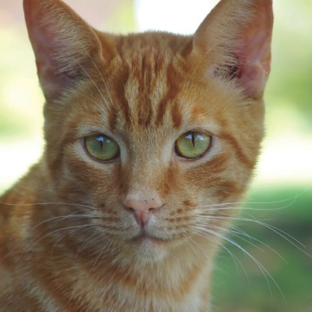


Some example materials from Jigsaw
– younger children
Notes:
Share some of the materials used so everyone can see what it looks like.

Slide 12
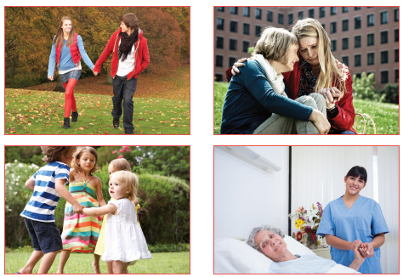
Example of a relationships resource for KS1
Notes:
SRE also covers different relationships too.

Slide 13
How Jigsaw teaches about different families in Y1
Notes:
Different family composition
We use cartoons as distancing tools
This PP is used to show lots of different families on the planet Zarg including those with adopted or fostered children, single parents, same gender parents etc. This is preceded by a matching game where children identify different animal families. After the PP show the children draw and label their own family. Same gender families are simply explained as those with 2 mums or 2 dads.

Slide 14

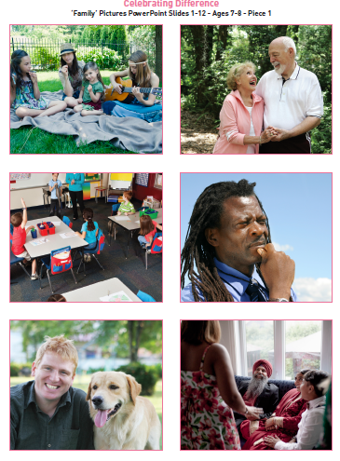
How Jigsaw teaches about different families in Y1
Notes:
WE also use images and ensure a range of images aiming that every child can resonate with at least one image so feels included
The teacher uses these pictures to show a range of families. Children discuss in groups and come up with a definition A Family is…
The lesson notes also help challenge stereotypical families and encourage children to think about other types of family that are not represented e.g. military families, adoptive families. Same gender families are not taught in isolation – just as another family type.

Slide 15
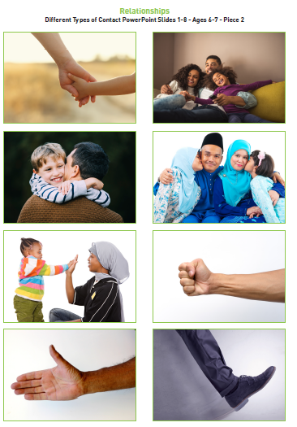
How Jigsaw teaches about inappropriate contact in Y2
Lesson starts with a Connect Us tracing game - where pupils trace letters on each other’s hands with their finger
Then paired work - how touch is used as a form of communication - good and bad ways
Children are shown the PowerPoint and discuss how kind and bad touches make us feel. Teacher also asks for strategies if someone is experiencing a touch they don’t like.
Individual work, children draw around their hand and write on the handshape what touches they like/ don’t like and why.
Teacher notes stress to follow safeguarding procedures if disclosures are made.

Slide 16
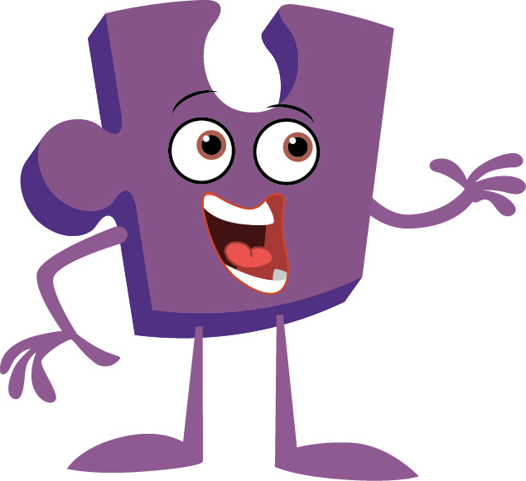
Any questions?

Slide 17
KS2 Puberty and Human Reproduction in Changing Me Puzzle
Y3 | Body changes | How our bodies need to change so they can make babies when we grow up – outside changes and how we feel about them
Y4 | Having a baby | The choice to have a baby, the parts of men and women that make babies and – in simple terms – how this happens (animations used – the Female Reproductive System)
 | Girls and puberty | How a girl’s body changes so that she can have a baby when she’s an adult – including menstruation (animations used – the Female Reproductive System)
Y5 | Puberty for girls | Physical changes and feelings about them – importance of looking after yourself (animations used – the Female Reproductive System)
 | Puberty for boys | Developing understanding of changes for both sexes – reassurance and exploring feelings (animations used – the Male Reproductive System)
 | Conception | Understanding the place of sexual intercourse in a relationship and how it can lead to conception and the wonder of a new life (animations used – the Female and Male Reproductive Systems)
Y6 | Puberty | Consolidating understanding of physical and emotional changes and how they affect us (animations used – the Female and Male Reproductive Systems)
 | Girl talk / boy talk | A chance to ask questions and reflect (single sex) (animations used – the Female and Male Reproductive Systems)
 | Conception to birth | The story of pregnancy and birth (animations used – the Female and Male Reproductive Systems)
Notes:
Notes:
Conception is introduced age appropriately in Y4 in the context of why our bodies change during puberty. Note that one lesson in Y4 is called Puberty for girls, this doesn’t exclude the boys, it covers them too, but the main focus is on menstruation.
Conception and puberty is built upon in Year 5 and then puberty, conception and childbirth is covered in more detail (but still age-appropriately) in Y6 with a chance for single gender group lessons (up until this point lesson shave all been mixed gender).
Remind the parents/carers that when moving to secondary school Sex Ed is compulsory so there is an expectation that children will be moving into Y7 with some knowledge.

Slide 18
KS2 resource- Outside changes for girls/females in puberty

Slide 19
KS2 resource
- outside changes for boys
(also in range of skin tones)

Slide 20
Example of one of the KS2 resources
- inside body changes for boys

Slide 21
Example of one of the KS2 resources
- inside body changes for girls

Slide 22
Example of a KS2 resource
- conception and childbirth

Slide 23
Any questions?

