Slide 1
Writing
At Escrick c of e primary school

Slide 2
Writing at Escrick
Our approach to English at Escrick School focuses on the core skills (phonics, reading, writing and letter formation) and is brought to life through creative and engaging learning experiences.
We read and plan from a range of rich texts and ensure writing opportunities are given across the curriculum.
Our Long Term Plans cover a range of text types and genres, such as persuasive writing and biographies as well as traditional fiction such as stories in familiar settings and traditional tales.
Each term we also cover a unit of poetry with a focus on vocabulary, word play and performance.

Slide 3
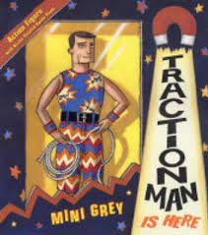
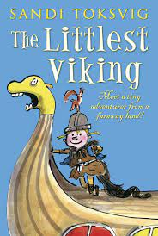
Writing Curriculum – text focused
Our Curriculum for writing is text based.
Each class topic is based on a quality text that promotes writing opportunities in different subjects.
For example – Traction Man in Year 2 is about a superhero toy brought to life by his owner. This makes a link between materials in Science and story writing.
In Year 4, children read ‘The Littlest Viking’ which is a funny story about a Viking girl in modern times. This makes links between History and story writing.
In Year 6, children study ‘Trash’ which has links to global issues and is an exciting and thought-provoking read.

Slide 4
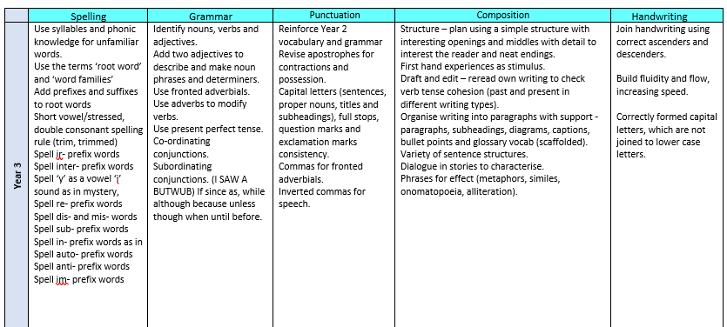
Progression
Our writing curriculum is progressive across all elements of writing.
Spelling, grammar, handwriting, composition and punctuation.

Slide 5
Punctuation progression
Year 1 | Year 2 | Year 3 | Year 4 | Year 5 | Year 6
Capital letters, full stops, question marks and exclamation marks. Capitals for names, proper nouns and personal pronoun I. | Capital letters, full stops and exclamation marks. Commas in a list. Apostrophe for contraction and possession. Beginning inverted commas for speech. | Consolidate Year 2 vocabulary and grammar Revise apostrophes for contractions and possession. Capital letters (sentences, proper nouns, titles and subheadings), full stops, question marks and exclamation marks consistency. Commas for fronted adverbials. | Reinforce Year 2 and Year 3 vocabulary and grammar Revise apostrophes for contractions and possession. Capital letters (sentences, proper nouns, titles and subheadings), full stops, question marks and exclamation marks consistency. Commas for fronted adverbials. Ellipsis. | Recap content from Y3, 4. Begin to use: Semi colon, colon and dash. Parenthesis – brackets, commas and hyphens. Commas between clauses. Commas before conjunctions and after adverbials. Bullet points to list information. Ellipses as cohesive device. Direct and reported speech. | Recap content from Y3, 4 and 5. Confidently use: Semi colon, colon and dash. Parenthesis – brackets, commas and hyphens. Commas between clauses. Bullet points to list information. Ellipses as cohesive device.
Each year group recaps the previous year and builds in new elements. Punctuation is often about following and applying a rule so this skill is something that needs practise to embed.

Slide 6
How is it taught?
Daily writing sessions and opportunities to write in other subjects.
The key focus of English lessons is the class text or a model text.
Children spend time reading this, discussing it and picking apart the key features of the grammar and vocabulary used.
Time is given to practise using new vocabulary and apply grammatical features discretely before then using this in their own writing.
Towards the end of a unit, planning and drafting a longer piece of writing will take place.
From Year 2 upwards, children are taught how to edit and improve writing by adding/changing vocabulary or adding in specific features to make it better for the reader.

Slide 7
How is writing assessed?
Each term, teachers give children the opportunity to complete a ‘cold write’ – this is usually around 3 to 4 weeks after a unit has been taught.
This is effectively where they are given a genre and a topic and are asked to write.
There may be some guidance with planning or time to talk, draw or act out their ideas.
It is a chance for children to show what they can do when they are not heavily guided or scaffolded by the teacher.

Slide 8
Assessment
We assess writing each term and use the specific year group criteria that cover the key areas of writing as mentioned at the beginning:
Spelling
Handwriting
Composition
Punctuation
Children are encouraged to use resources in the classroom to help them with their writing, such as dictionaries, thesauruses, word banks and displays.

Slide 9
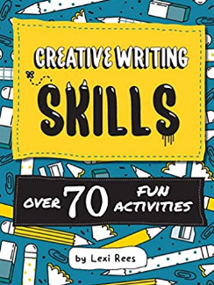
Support with writing at home
Spelling – practise the weekly spellings
Encourage them to sound out and spell words themselves and read it back to check
Keep a diary – especially at half term or during the holidays
Read quality texts together – no matter their age or reading ability, even listening to texts by great authors can have an impact on the quality of their writing.
Write whenever and wherever you can – get them to help write the shopping list, make a poster for a lost item, write a letter to a family member, a thank you card, etc.
Creative writing skills – Lexi Rees. Fun ideas and prompts for creative writing.

